Slide 1
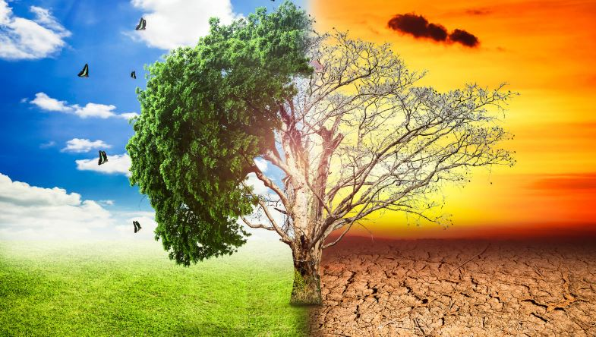
Global warming
Welcome to the Presentation of
Sheikh Mohammod Sholaman Shanto

Slide 2
Causes of Global Warming
Human Activities
Burning of Fossil fuels
Deforestation
Natural Factors
Volcanic Eruptions
Solar Activity
Feedback Mechanism
Melting Icecaps

Slide 3
Effects of Global Warming
Category | Effects
Rising Temperature | Increased global temperature, More frequent heat waves.
Sea Level Rise | Costal flooding and submersion of low-lying areas due to melting ice and thermal expansion.
Ocean Changes | Ocean Acidification, Coral Bleaching.
Ecosystem shifts | Altered migration patterns.

Slide 4
Contribution of various Sectors to Global Warming

Slide 5
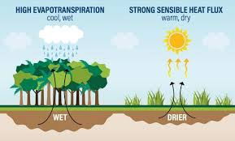
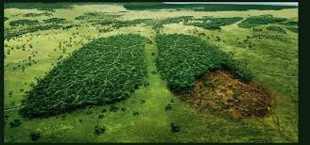
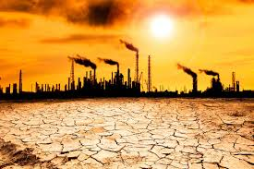
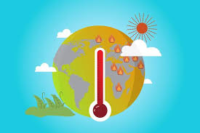
Some snaps of Global warming

Slide 6
Thank You

